Slide 1
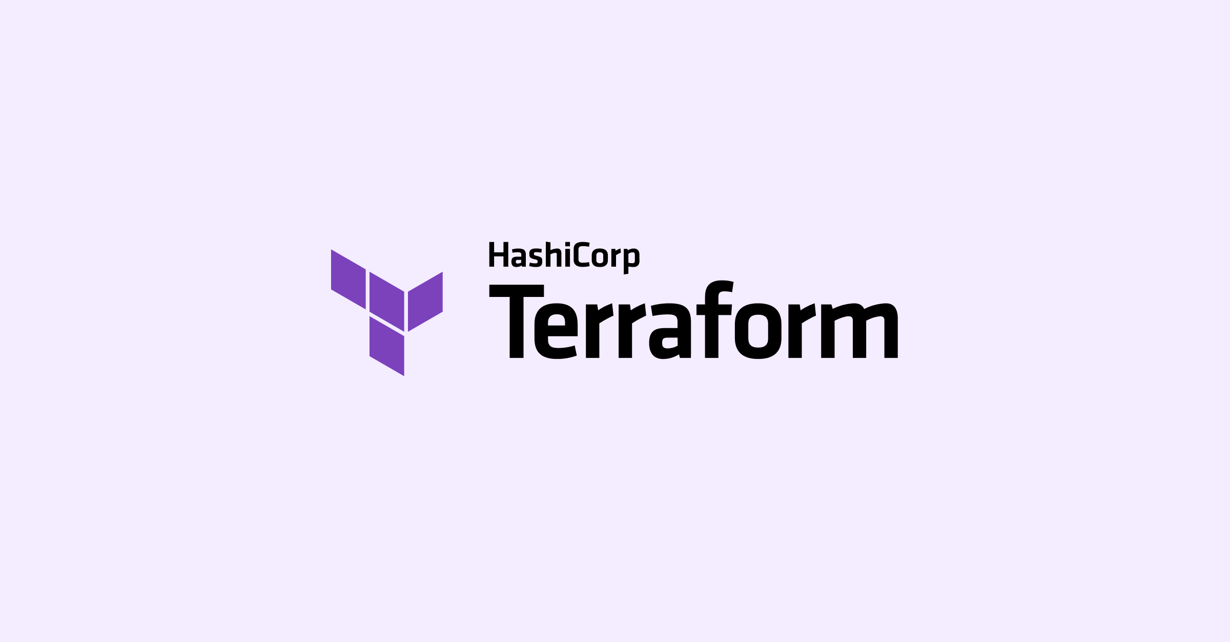
An introduction to infrastructure as code

Slide 2
What is terraform
an infrastructure as code (IaC) tool that lets you define both cloud and on-prem resources in human-readable configuration files that you can version, reuse, and share
Open-source tool created by HashiCorp
Cloud agnostic (many providers ie. AWS, Azure, GCP, GitHub etc (>1000!)
Can be used to manage:
Low level components: compute, storage, networking
High level components: DNS, SaaS
Alternatives provided by cloud platforms
AWS – cloudformation
Google Cloud Platform – Deployment Manager

Slide 3
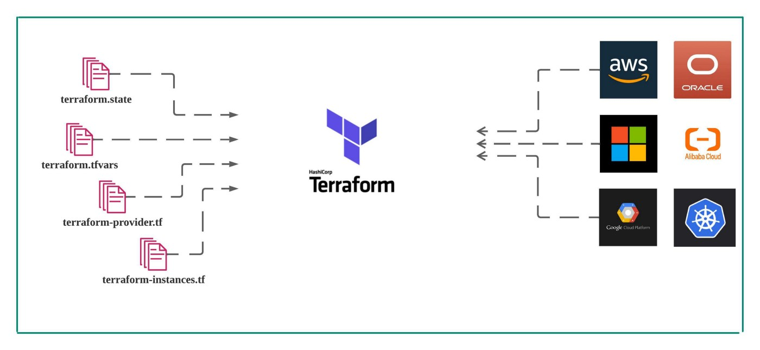
Notes:
Platform and cloud agnostic
One workflow to provision, secure, audit and control infrastructure
Increases productivity, reduces risk as a consistent approach to multi-cloud provisioning

Slide 4
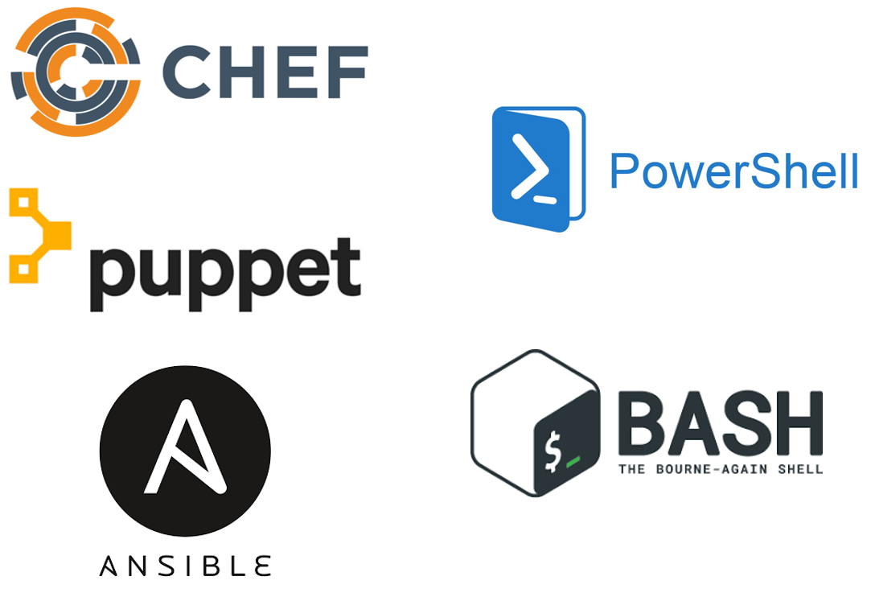
Other IaC Tools
These tools work well for configuring the operating system and application.
They are not purpose-built for provisioning cloud infrastructure and platform services

Slide 5
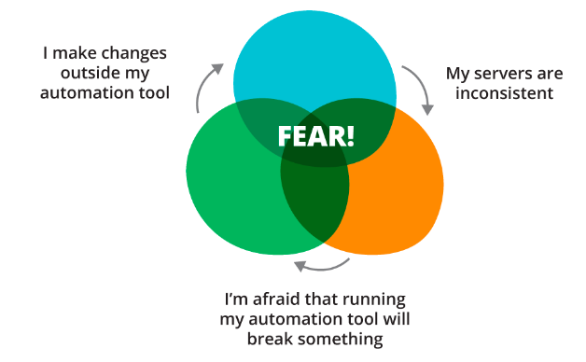
Advantages
Reduce costs by eliminating vendor lock-in
Reduce risk with a single workflow to secure, govern, and audit
Increase productivity with a consistent workflow and reduce time to onboard vendors
Open-source and massive community – has become the standard tool
Reduce time to provision
Easily validate and preview infrastructure changes before they are applied
Automated management is safer, faster and more predictable
Reusable modules allow for standard configurations

Slide 6
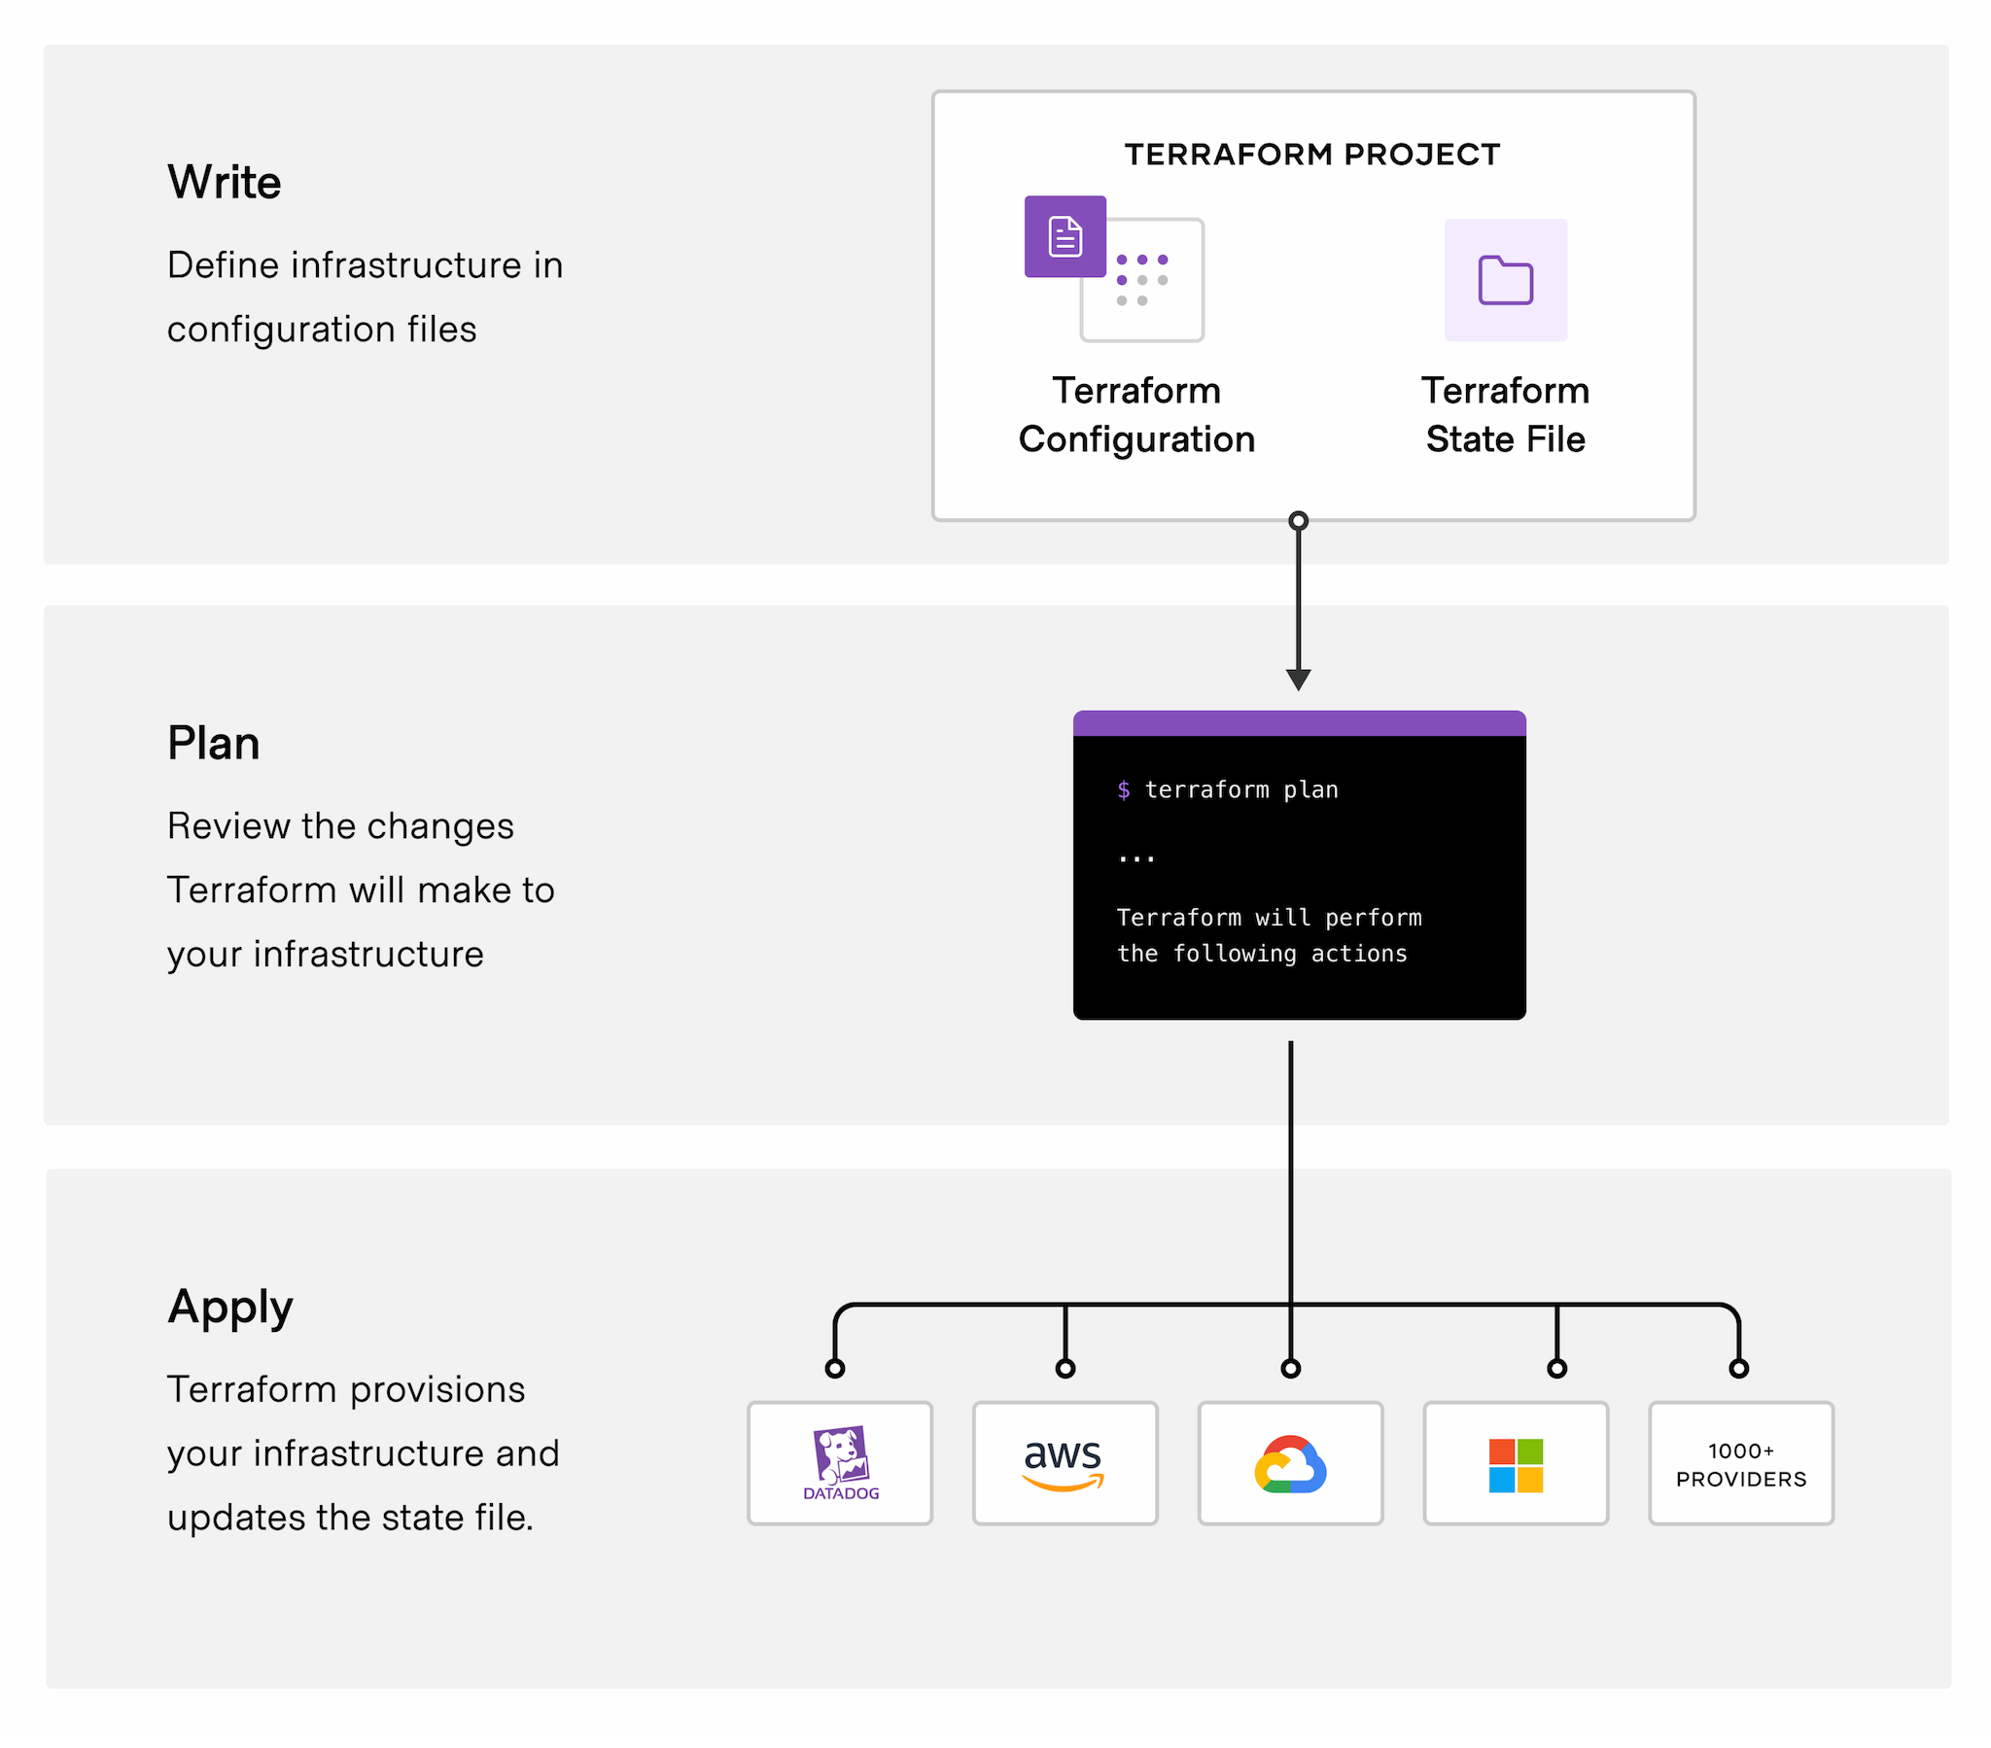
Terraform workflow
Notes:
Write: You define resources, which may be across multiple cloud providers and services. For example, you might create a configuration to deploy an application on virtual machines in a Virtual Private Cloud (VPC) network with security groups and a load balancer.
Plan: Terraform creates an execution plan describing the infrastructure it will create, update, or destroy based on the existing infrastructure and your configuration.
Apply: On approval, Terraform performs the proposed operations in the correct order, respecting any resource dependencies. For example, if you update the properties of a VPC and change the number of virtual machines in that VPC, Terraform will recreate the VPC before scaling the virtual machines.

Slide 7
Declarative
Terraform plugins (aka. providers) define individual units of infrastructure ie. compute instances or private networks as resources
Resouces can be compiled into reusable Terraform configurations called modules and managed with a consistent language and workflow
Terraform’s language is declarative – it describes the desired end-state for your infrastructure
This is in contrast to procedural languages – which require step-by-step instructions to perform tasks (ie. Ansible is procedural)

Slide 8
LIVE DEMO - 1: Setup
Install terraform
Manually or with homebrew or yum/apt-get
Verify terraform is installed
terraform –version
Optional: can install terraform auto-complete for tab completion
terraform -install-autocomplete
Try terraform help

Slide 9
Basic CLI commands
terraform init
Initialises a working directory containing Terraform configuration files
terraform plan
Creates an execution plan, which lets you preview the changes that Terraform plans to make to your infrastructure.
terraform validate
Validates the syntax and arguments of the Terraform configuration files in a directory, including argument and attribute names and types for resources and modules.
terraform apply
Executes the actions proposed in a Terraform plan to create, update, or destroy infrastructure.
terraform destroy:
Destroys all objects managed by a Terraform configuration.
terraform fmt
Used to rewrite Terraform configuration files to a canonical format and style.

Slide 10
HCL (HashiCorp Configuration Lanaguage)
Native Terraform language is HCL – designed to be human readable
JSON can also be used
CloudFormation JSON (expected by any files with a .tf.json suffix)
)
Terraform (for any files with .tf suffix
"Tags": [{
"Key": "Name",
"Value": { "Fn::Join:": ["-", [{ "Ref": "ServerName" }, "vm"]] }
}]
tags {
Name = "${var.ServerName}-vm"
}

Slide 11
Terraform workspaces
A terraform workspace is simply a folder or directory that contains terraform code.
Terraform files always end in either a *.tf or *.tfvars extension
Most terraform workspaces contain a minimum of three files:
main.tf - Most of your functional code will go here. variables.tf - This file is for storing variables. outputs.tf - Define what is shown at the end of a terraform run.

Slide 12
Live demo 2 – create a local nginx server
Clone the training repo:
https://github.com/fsanderson/terraform-devday.git
cd 1-nginx-server
Make sure docker is installed and running

Slide 13
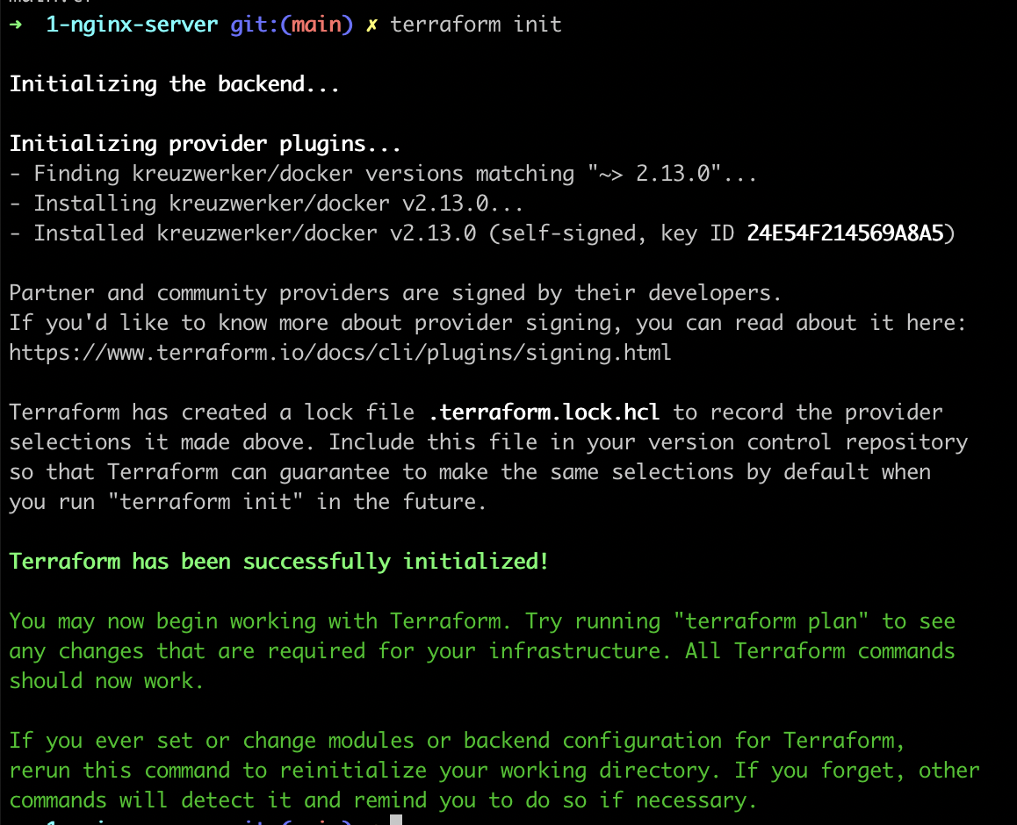
Terraform init
Terraform fetches any required providers and modules and stores them in the .terraform directory. If you add, change or update your modules or providers you will need to run init again.
Here, we’re downloading a plugin that allows Terraform to interact with Docker.

Slide 14
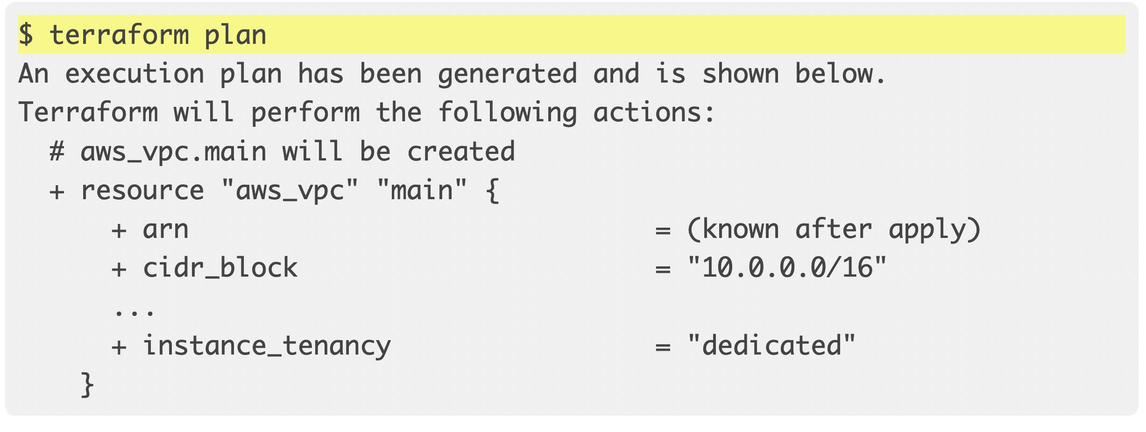
Terraform plan
Preview your changes with terraform plan before you apply them.

Slide 15
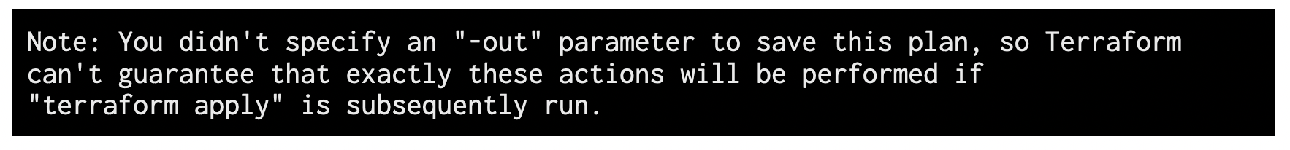
Optional – save your plan
You may have noticed this output when you ran terraform plan:
If you specify the -out parameter, you can save your Terraform plan in a file and run it later.

Slide 16
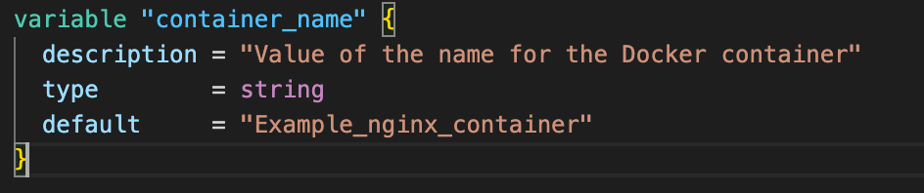
Variables – input variables
Like function arguments
Declared using a ‘variable’ block
Use the variables.tf file to organise variables
Note – this isn’t actually required – terraform loads all files ending in .tf but it’s a standard practice
Can be accessed with var.<NAME>
If default omitted, the user will be prompted to enter a value
Variables can be set:
On the command live with –var (ie. terraform apply -var=”container_name=test”
In variable definitions files (terraform.tfvars or terraform.tfvars.json)
As environment variables (export TF_VAR_container_name=test)
Action: set the container_name var to something meaningful

Slide 17
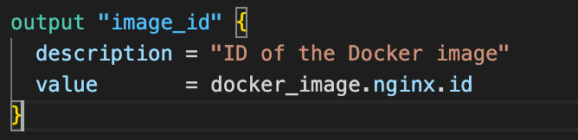
Variables - Output variables
Like function return values
Gives you information on your infrastructure on the command line
Declared using ‘output’ blocks
Here, ‘image_id’ is the name
This is displayed to the user
In child modules, can be used to access the output value
‘sensitive’ – hides values in CLI output
Use the outputs.tf file to hold output variables
Outputs returned on terraform apply (and not plan)

Slide 18
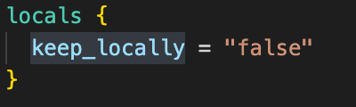
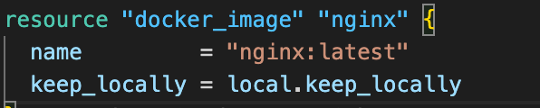
Variables - Local variables
Like a function's temporary local variables
Can be declared in a ‘locals’ block
Can reference other values (not just literal constants)
Once declared, can be references with local.<NAME>

Slide 19
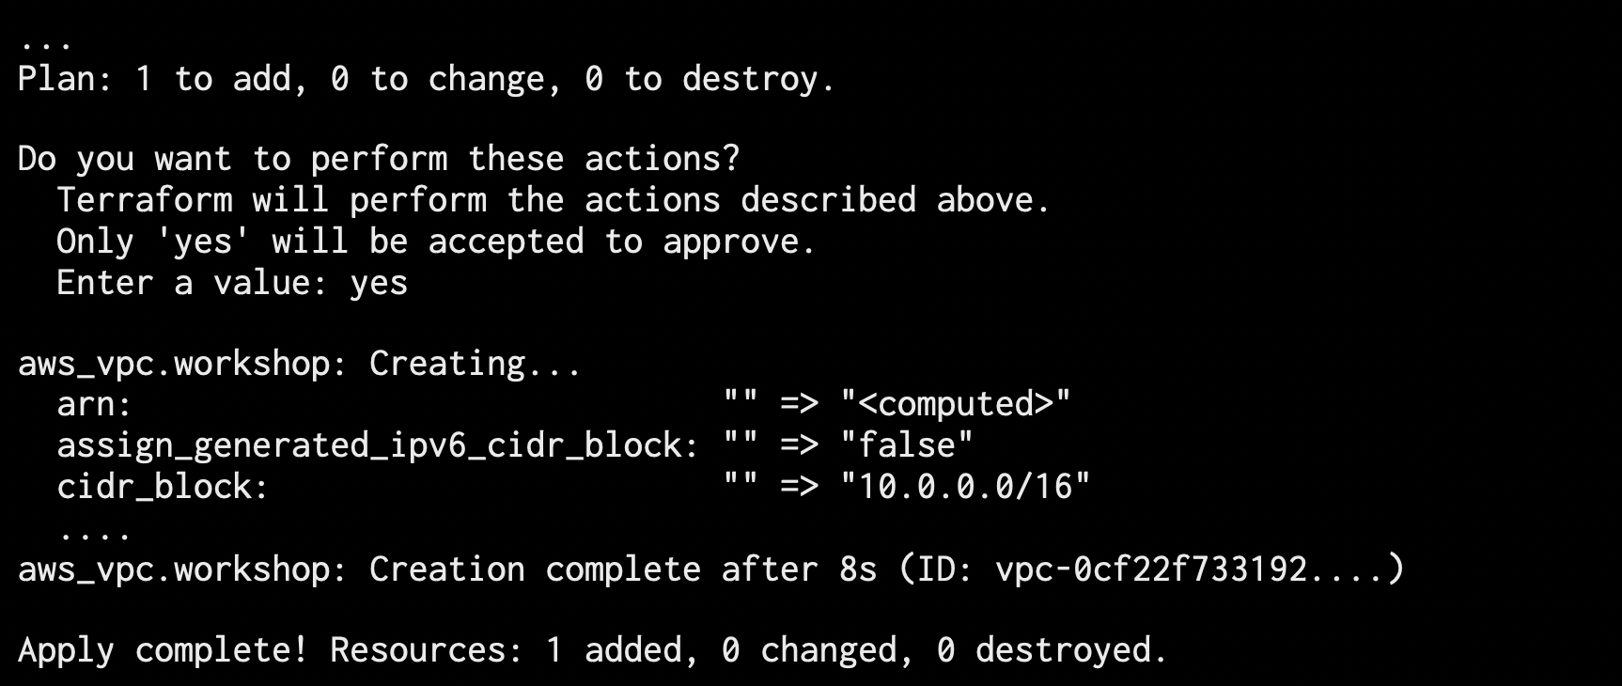
Terraform apply
Run the terraform apply command to execute the code and build a resource group. Type 'yes' when it prompts you to continue.
Command:
Terraform apply
Output:

Slide 20
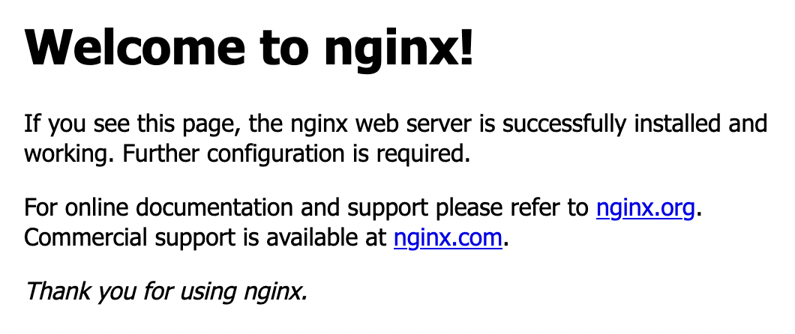
Verify the existence of the NGINX container by visiting localhost:8000 in your web browser or running docker ps to see the container.
docker ps
To see that the container is running

Slide 21
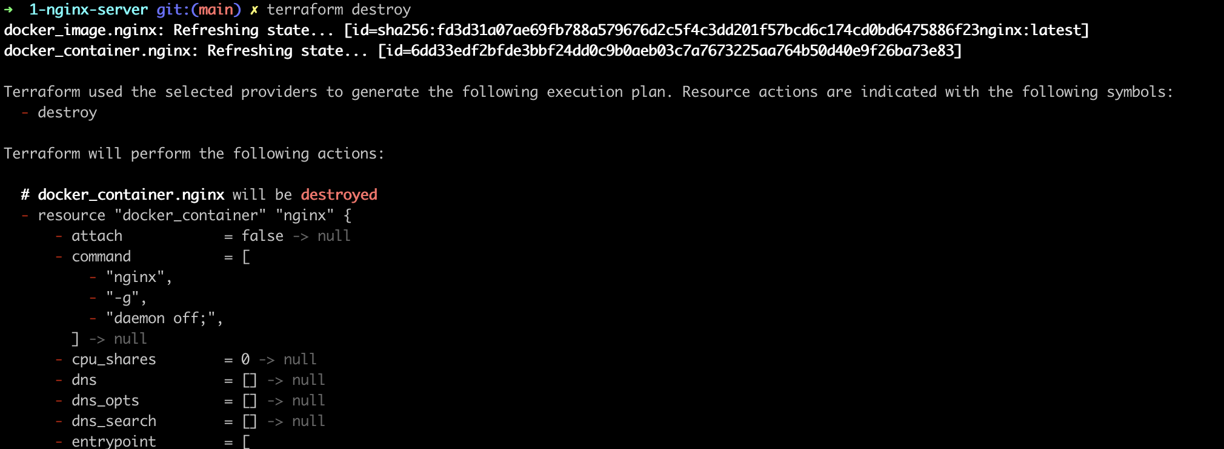
Terraform destroy
To stop the container, run terraform destroy.
You've now provisioned and destroyed a local NGINX webserver with Terraform!
Optional: try applying again with a command line container_name env var
Optional: try changing the port number and seeing what happens with terraform plan

Slide 22
Live demo 3 – Create an ec2 instance on aws
Install AWS CLI
aws –version
Get your AWS access key ready
export AWS_ACCESS_KEY_ID=
export AWS_SECRET_ACCESS_KEY=

Slide 23
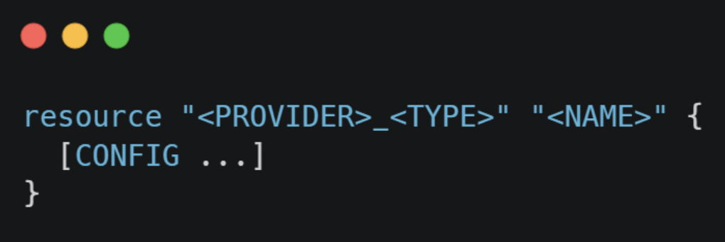
Terraform resources
Each resource element describes one or more infrastructure objects
Resources are declared in blocks with a set structure
resource = top level keyword
type = the type of resource to create in that provider. The first part tells you which provider it belongs to. Example: aws_instance. This means the provider is AWS and the specific type of resource is a virtual machine.
name = arbitrary identifier used to refer to this resource. Used internally by terraform. This field cannot be a variable.
NB: resource type + name works as the identifier for that resource so must be a unique combination ie. aws_instance.app_server
Resource blocks contain arguments for that resource. Use the provider reference documentation to find optional and required arguments

Slide 24
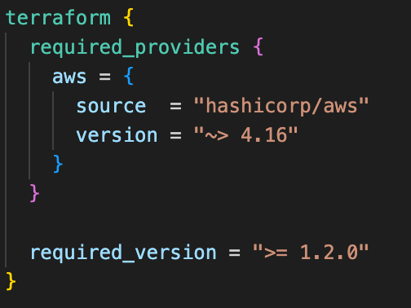
Terraform block
Terraform settings are defined in a top-level terraform block
Only constant values can be used in a Terraform block
required_providers
needs a local name, a source location and a version constraint
local names
only used within a module and must be unique per module
can be anything but most providers have preferred names (which you should use ie. aws)
Source
Ie. Address within terraform registry
Version
Optional but strongly recommended (terraform init will generate a lock file)
Best practice to provide the minimum version (and if a root module, also a maximum version)
required_version – version of Terraform to use

Slide 25
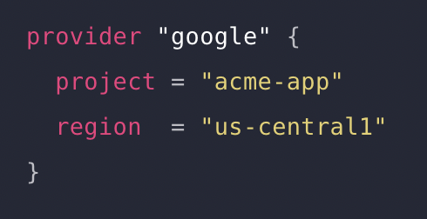
providers
At least one provider is required for Terraform to build anything
Can develop your own providers
Default method is to use a provider registry (defaults to Terraform but can use others)
Other methods of installation are available ie. provider_installation block allows installation from local file directory
The provider block allows the provider configuration
The name is the local name for that provider (should already be in the required_providers block) ie. ‘google’
Configuration arguments are specific to the provider
Can use expressions ie. input variables but only those known before the configuration is applied
Can specify an ‘alias’ within the arguments list
If there are multiple configurations for the same provider, use multiple provider blocks with alias

Slide 26
Live demo 3 -
Navigate to the folder ‘2-single-ec2’
Check out the AWS provider documentation - https://registry.terraform.io/providers/hashicorp/aws/latest/docs
terraform init – Note that terraform has downloaded the provider and installed it in the .terraform directory
Change the AWS region
Try ‘terraform validate’ which will validate your configuration
Try ‘terraform fmt’ to format your configuration (try terraform fmt –diff to see differences)
terraform plan
terraform init
terraform apply
Go to the ec2 instance in the console to see the new EC2 instance (in the right region)
terraform destroy
Now try creating two ec2 instances in different regions using providers with aliases
Use input variables to define the instance tags
Note that adding/removing tags is a non-destructive action! The resource is modified and not destroyed!

Slide 27
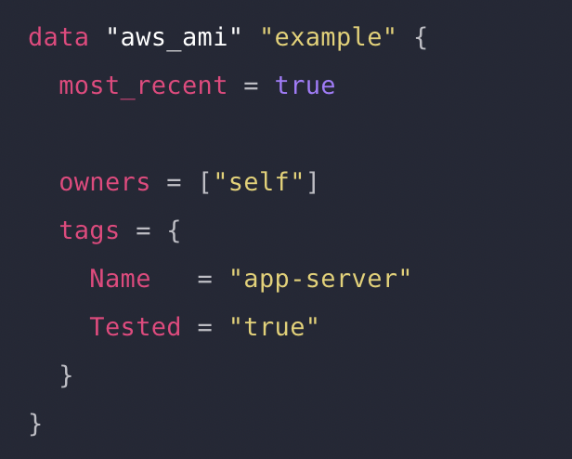
Data sources
A special kind of resource that lets you use information defined outside of Terraform
Each provider offers data sources (alongside its resource types)
Defined in a data block
Type – defines the data source ie. aws_ami
Name – used to reference the data source locally ie. example
Type + name forms a unique local identifier
Can then be used as a reference ie. data.<TYPE>.<NAME>.<ATTRIBUTE>
Data.aws_ami.example.id
Task: use a data source to look up an AWS AMI
Use that data source to set the AMI value for your EC2 instances

Slide 28
state
When configuration is applied, Terraform writes data into the terraform.tfstate file.
This is the state file, which stores the id and properties of your resources
For a team/production environment, this should be stored remotely and securely
Terraform show – lists the current state
Terraform state list – lists the resources held in your state
Terraform import – used to import existing infrastructure (in case changes are made outside of Terraform’s control)

Slide 29
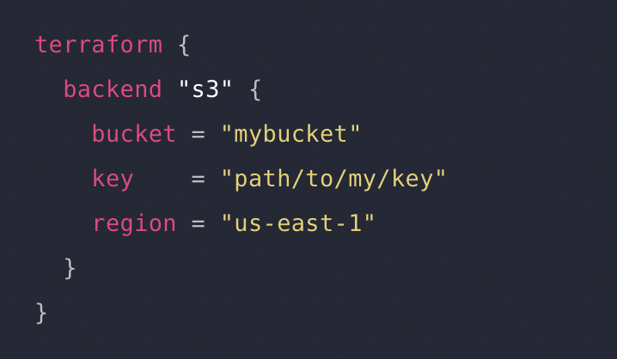
backends
Backends are configured with the backend block within the top-level terraform block
Default backend is local storage
S3 backend configuration:
Stores the state as a key in an s3 bucket
State locking and consistency can be supported via Dynamo DB table - dynamodb_table argument
Task: create an s3 bucket (with bucket versioning turned on!) and then add a backend block where the state can be stored
Task (optional): create a DynamoDB table and use it for state locking

Slide 30
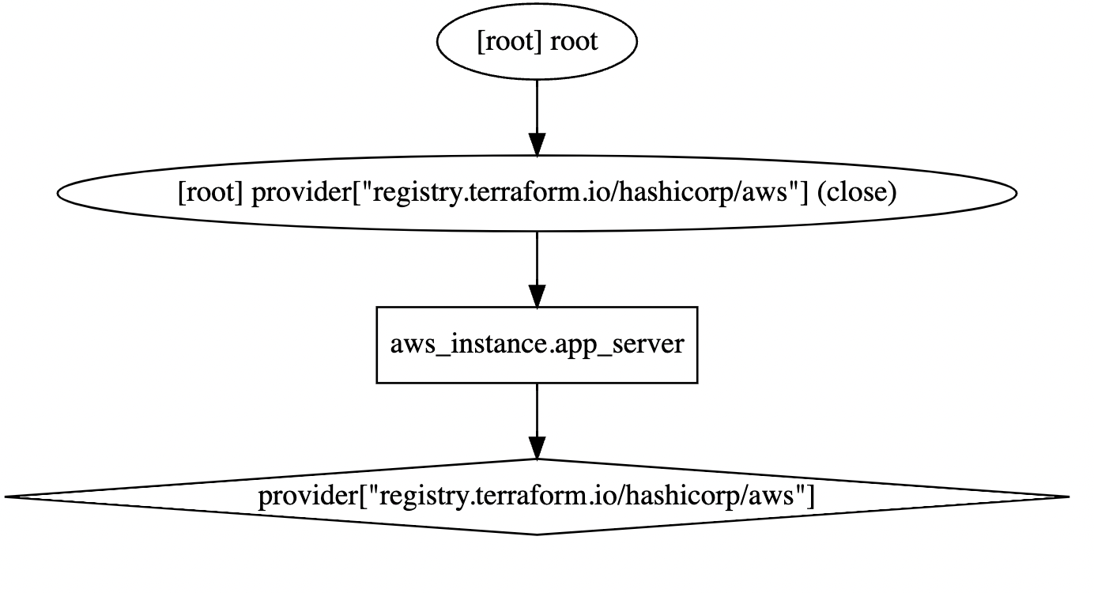
Terraform dependency graph
Visually depicts dependencies between resources
Output is in DOT format
Try terraform graph | dot -Tsvg > graph.svg

Slide 31
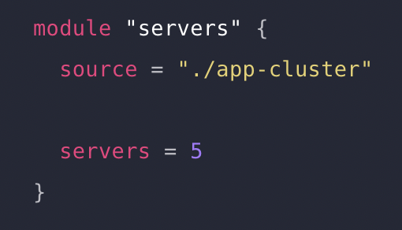
modules
Modules are a way to package a set of resources together – allows for resource configurations to be re-use, allowing for best practice configuration and reducing duplication
Every Terraform config has one module at least (the root module) – this is what we have so far
A root module can call other modules (child modules)
Modules can be called via module blocks
‘servers’ here is the local name
‘source’ argument is a required argument – either a remote module or a path to a local directory
Arguments within the module block define input variables for the child module
Must run terraform init after adding, removing or modifying a child module

Slide 32
Live demo 4: make a module
Made a module directory and move the existing main.tf, output.tf, variables.tf etc files into the directory
Call the child module from a top-level main.tf file
Example solution in ‘4-modules-solution’

